Slide 1
FASTAPI Development using Python on Cloud
FastAPI with Agentic AI on Cloud

Slide 2
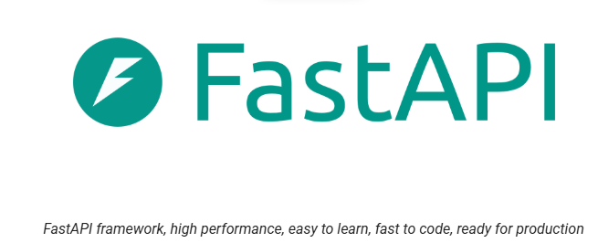
Overview of FASTAPI
FastAPI is a Python web-framework for building modern APIs.
Fast (Performance)
Fast(Development)
Features
Few Bugs
Quick & Easy
Robust
Standards

Slide 3
FastAPI Documentation
FastAPI is a web framework or building modern RESTful APIs.
Fast - Very high performance, on par with NodeJS and Go
Fast to code - Increase the speed to develop features by about 200% to 300%.
Intuitive - Faster code support , Less time debugging.
Robust – Designed to be automated Production ready code. With automatic interactive documentation.
Short – Minimize code duplication. Multiple features from each parameter's declaration.

Slide 4
FastAPI integration with Full Stack Architecture
FastAPI
​Web Page
Full Stack Application
Server
Handles all business logic for the application
Based on Two sets of API – OpenAPI and JSON Schema

Slide 5

FastAPI Documentary

Slide 6



Who has used FASTAPI?

Slide 7
Installation of Dependencies
Pip is the Python package manager.
Pip is used to install and update packages.
Use the latest version of pip installed.

Slide 8
Setting Up Virtual Environment
Start by new folder / directory called “FastAPI”
Within the pip check the dependencies that have been installed
Python already has an included dependency for virtual environments called venv.
Creating a new FastAPI environment as a virtual environment.
Activating out virtual environment to install our dependencies in

Slide 9

HTTP Request & Response
HTTP Request Methods
Web Page
Server
Create
POST
Read
Get
Update
PUT
Delete
Delete

Slide 10
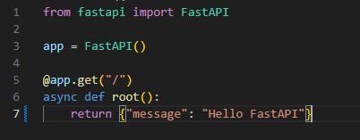
Creating FastAPI Application

Slide 11
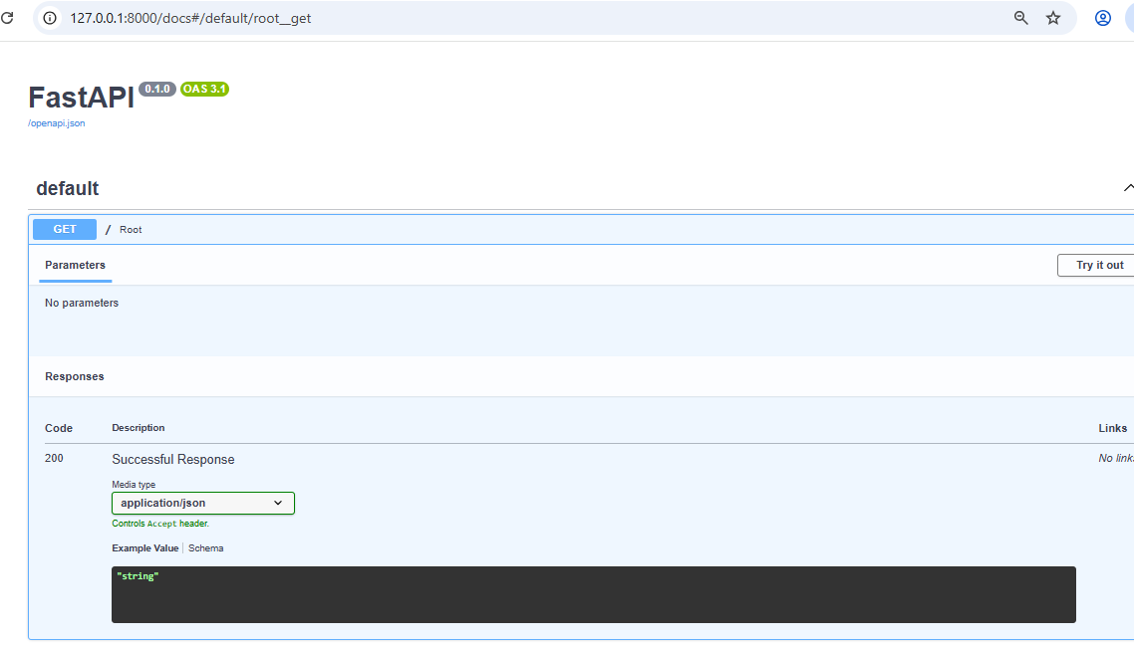
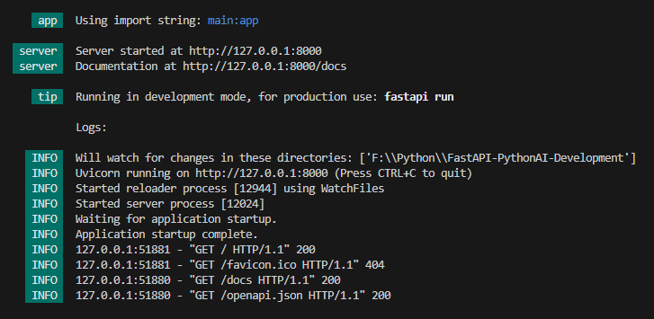
Running Your FastAPI App

Slide 12
Path Parameters
Path Parameters are request parameters which have been attached to the URL
Path Parameters are defined as a way to find information based on location
Like File system –
/Users/<username>/Documents/python/fastapi/section1

Slide 13
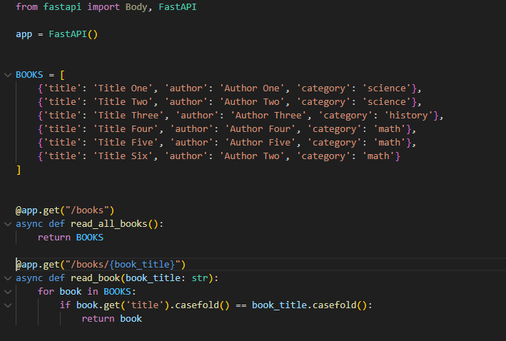
Books Project

Slide 14
Path Parameters
Request:
URL 127.0.0.1:8000/books
@app.get("/books")
async def read_all_books():
return BOOKS
Read
Get

Slide 15
Managing Order with Path Parameter
Request:
URL 127.0.0.1:8000/books/mybook
@app.get("/books/mybook")
async def read_all_books():
return {‘book_title’: ‘Java Book’}
@app.get("/books/{dynamic_param}")
async def read_all_books(dynamic_param):
return {‘dynamic_param’: ‘dynamic_param’}
Read
Get

Slide 16
Query Parameters
Query Parameters are request parameters which have been attached after a ”?”
Query Parameters have name=value pairs
Example – 127.0.0.1/books/?category=math

Slide 17
Query Parameter
Request
URL: 127.0.0.1:8000/books/?category=science
@app.get("/books/")
async def read_category_by_query(category: str):
books_to_return = []
for book in BOOKS:
if book.get('category').casefold() == category.casefold():
books_to_return.append(book)
return books_to_return

Slide 18
HTTP POST Request Method
Used to create data
POST can have a body that has additional information which GET does not have
Body structure:
{“title”: “Title Seven”, “author”: “Author one”, “category”:

Slide 19
Post Request Method
Request:
URL: 127.0.0.1/books/create_book
@app.post("/books/create_book")
async def create_book(new_book=Body()):
BOOKS.append(new_book)
Create
Post

Slide 20
HTTP PUT Request Method
Used to update data
PUT has a body which can have additional information like POST which GET can’t have
Example Structure:
{“title”: “Title Six”, “author”: “Author Two”, “category”:

Slide 21
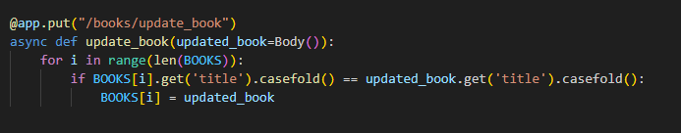
PUT Request Method
Update
Request:
URL: 127.0.0.1:8000/books/update_book
Put

Slide 22
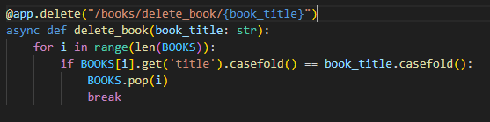
Delete HTTP Request Method
Delete
Used to delete data
Request:
URL: 127.0.0.1:8000/books/delete_book/{book_title}
Delete

